Slide 1
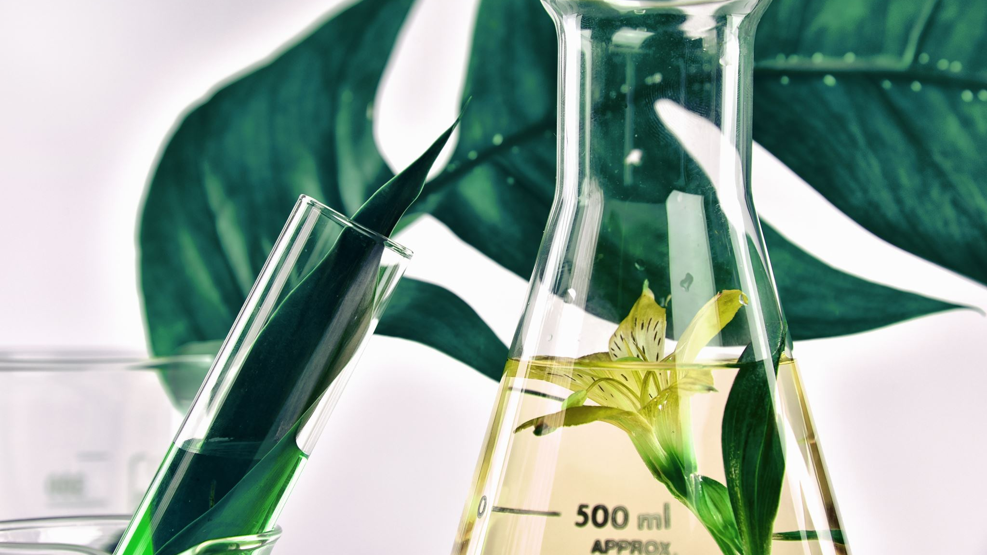
Plant Pathology Classifier
25 April 2022
Notes:
Misdiagnosis of the many diseases impacting agricultural crops can lead to misuse of chemicals leading to the emergence of resistant pathogen strains, increased input costs, and more outbreaks with significant economic loss and environmental impacts. Current disease diagnosis based on human scouting is time-consuming and expensive, and although computer-vision based models have the promise to increase efficiency, the great variance in symptoms due to age of infected tissues, genetic variations, and light conditions within trees decreases the accuracy of detection.

Slide 2
Team
Shem Freddy Pereira
Tina Jacob
Ziyad El Amrani-Joutey
Harsh Gupta
Robin Manchanda

Slide 3
Agenda
Introduction
Business needs and desired outcomes
Background Information
Business Need
Project Definition
Implementation details
Preliminary Options Analysis
Financial Analysis
Resources Required
Justification and Recommendation
Benefits/Risks
Implementation plan
Authorizations
Conclusion – Future Growth
Business Model Canvas

Slide 4
Introduction CV Tech start-up based in Toronto
Problem: Apple trees and plagued with various diseases, which increase cost of production and environmental impact due to incorrect use of pesticides
Goal: Detect apple tree diseases quickly to reduce use of chemicals/pesticides
Vision: To eliminate manual intervention in apple tree disease detection

Slide 5
Background Information
Problem of Misdiagnosis
Increased cost and environmental impact
Emergence of new strains of diseases
Time consuming process
Notes:
Misdiagnosis of the many diseases impacting agricultural crops can lead to misuse of chemicals leading to the emergence of resistant pathogen strains, increased input costs, and more outbreaks with significant economic loss and environmental impacts. Current disease diagnosis based on human scouting is time-consuming and expensive, and although computer-vision based models have the promise to increase efficiency, the great variance in symptoms due to age of infected tissues, genetic variations, and light conditions within trees decreases the accuracy of detection.

Slide 6
Business Need
U.S Apple Industry is worth $15 billion annually
Millions of dollars in annual losses due to loss of fruit bearing trees
Constant threat from insects and diseases
Results in unappealing cosmetic appearance which reduces marketability
Notes:
The U.S. apple industry, annually worth $15 billion, experiences millions of dollars in annual losses due to various biotic and abi-otic stresses, ongoing stress management, and multi-year impacts from the loss of fruit-bearing trees. Over the growing season, apple orchards are under constant threat from a large number of insects, as well as fungal, bacterial, and viral pathogens, particularly in the northeastern United States (Fig. 1). Depending on the incidence and severity of infection by diseases and insects, impacts range from unappealing cosmetic appearance, low marketability, and poor quality of fruit, to decreased yield or complete loss of fruit or trees, causing huge economic losses (Sutton et al., 2014). Early pest and disease detection are critical for appropriate and timely deployment of disease and pest management programs (Bessin et al., 1998)

Slide 7

Project Definition
Given a photo of an apple leaf, we need to assess its health by distinguishing between:
leaves which are healthy
those which are infected with apple rust
those that have apple scab
those with more than one disease.

Slide 8
Implementation Details
We will install cameras on drones to fly around and take pictures of leaves from different angles
Each drone can cover 1 tree in 2 mins. Around 500 trees per day, Scan entire farm in 5-6 days.
We can add more drones to cover larger orchards depending on requirements
Notes:
Misdiagnosis of the many diseases impacting agricultural crops can lead to misuse of chemicals leading to the emergence of resistant pathogen strains, increased input costs, and more outbreaks with significant economic loss and environmental impacts. Current disease diagnosis based on human scouting is time-consuming and expensive, and although computer-vision based models have the promise to increase efficiency, the great variance in symptoms due to age of infected tissues, genetic variations, and light conditions within trees decreases the accuracy of detection.

Slide 9
Preliminary Options Analysis SWOT Analysis
Strength: state of art AI model, team of highly skilled developers
Weakness: high initial cost of implementation, imbalanced dataset
Opportunity: not many competitors, large market opportunity, no system in place(manual), future scope of expansion.
Threat: farmers’ resistance to change, hardware damages

Slide 10
Financial analysis
Software Development cost (disease detection) : $ 10 million
Software License Cost (path optimization): $1000 per drone per year
Cost of each drone $2000
___________________________________________________________
We charge 30$ per apple tree * 5000 trees per orchard (approx) = $150K per orchard
Our cost per orchard: 2 drones ($6000) + other variable expenses + portion of initial fixed cost

Slide 11
Resources Required
Human: Developers, Project Managers, CEO, scouting agents
Infrastructure: Cloud training and deployment costs
Hardware: Drones, HD Camera
Software: Software License
Legal: Government approvals, Lawyers

Slide 12
Risks/Benefits
Risks:
Bad weather conditions:
Imbalanced dataset
Wrong detection
Different photos in different weather conditions
Benefits:
Reduced financial and environmental costs
Reduced human intervention
Massive Scale-up options

Slide 13
Authorizations
Department of Aviation
Department of Agriculture and Farming

Slide 14
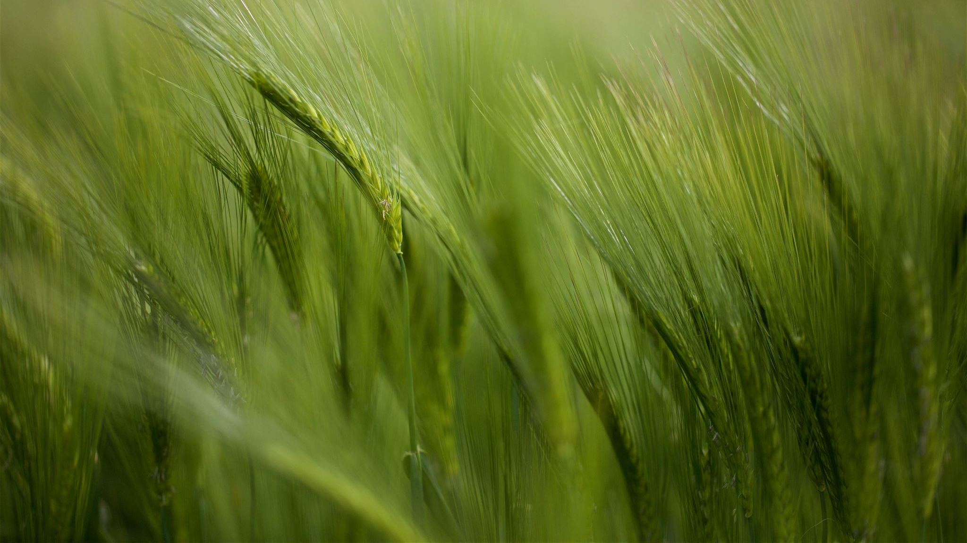
Implementation Plan
Developing and testing software
Beta rollout on few selected farms
Receiving required approvals
Scouting agents to find and contact farm owners
Present plan to them showing cost/benefit analysis and how it will save them time, money and other resources
Use same technology for other crops/diseases
Business expansion

Slide 15
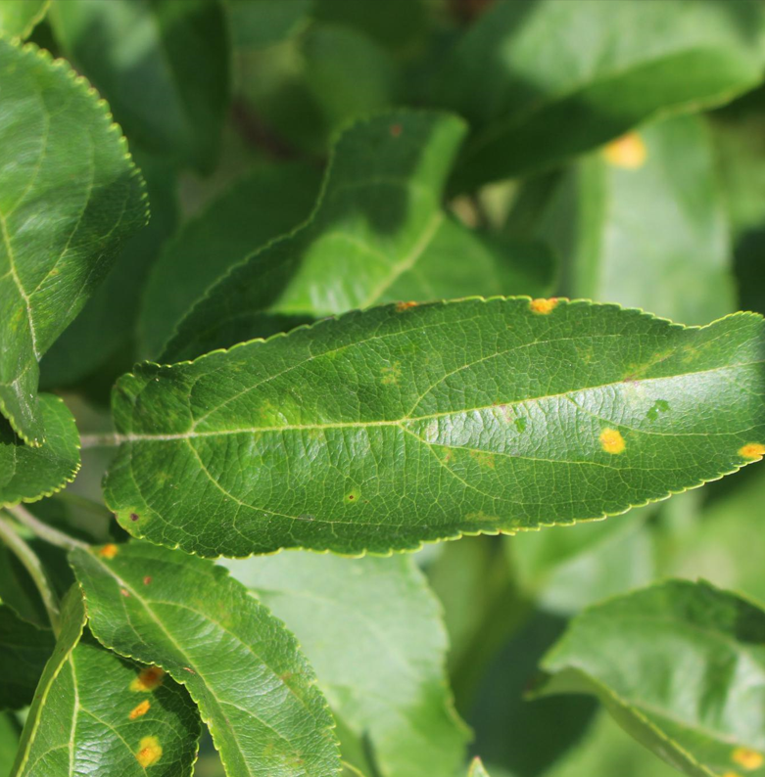
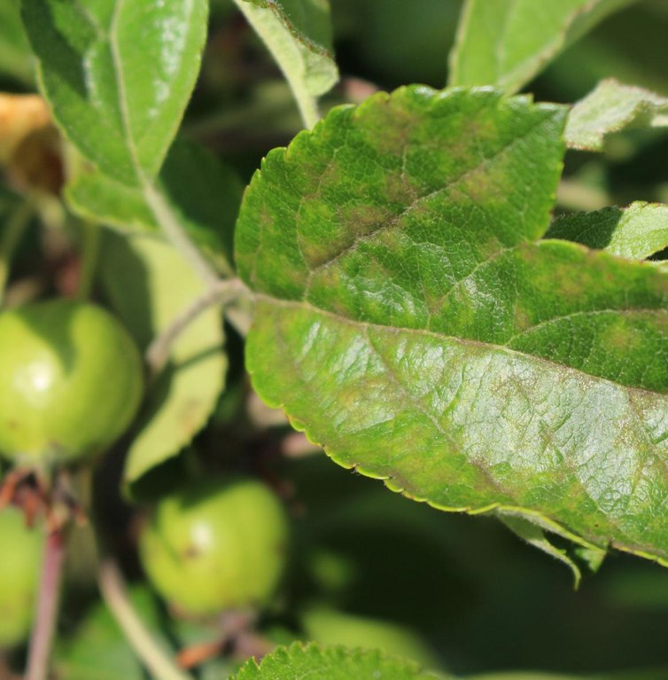
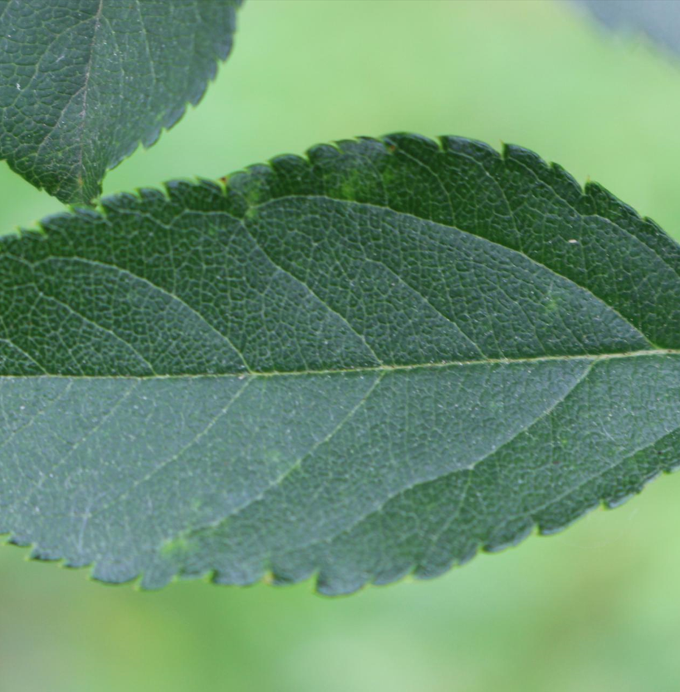
Dataset
3642 total images
1821 train images (labelled) : 515 healthy, 90 multiple, 621 rust, 591 scab

Slide 16
Model
Custom CNN
Custom deep CNN with data augmentation
Transfer Learning (Inception)

Slide 17
Results
Model | Training Accuracy | Training loss | Validation Accuracy | Validation Loss
CNN | 0.9856 | 0.0783 | 0.5055 | 2.2945
Deep CNN | 0.8490 | 0.4053 | 0.8516 | 0.3898
Transfer Learning | 0.9163 | 0.2249 | 0.8104 | 0.7106

Slide 18
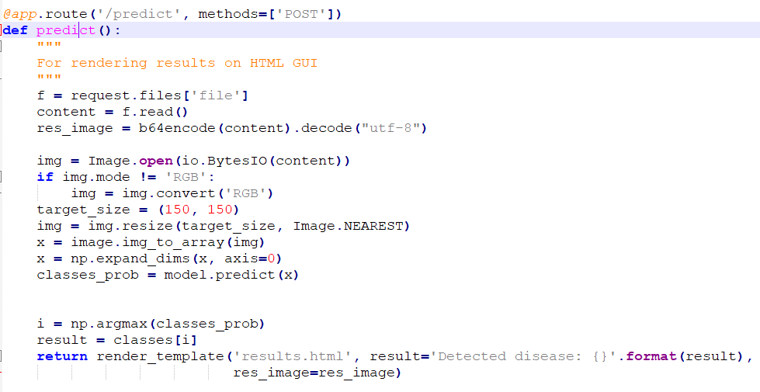
Deployment
Flask

Slide 19
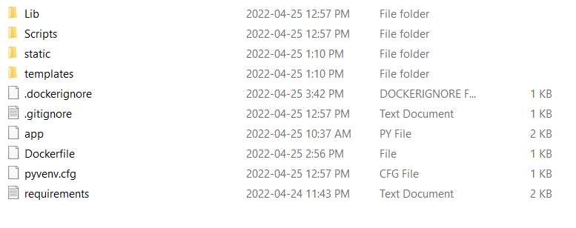
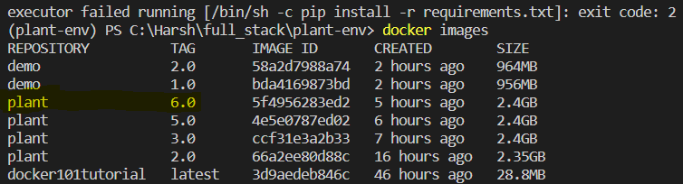
Docker

Slide 20


Google Cloud

Slide 21
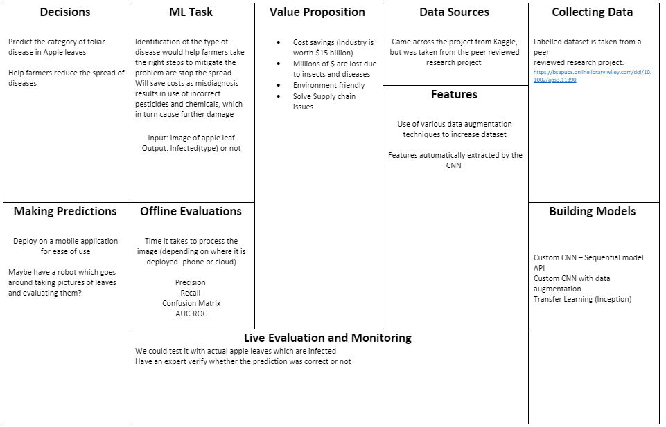
ML Canvas

Slide 22
Conclusion – Future Growth Aspects
Scale would further reduce costs
Improving hardware and software aspects of the product
Technology can be extended for other diseases and crops
Expansion into Europe and other potential markets
Flashlight can be added to drones to work at night as well
Drones can be used to collect more data, thus further refining the whole pipeline

Slide 23
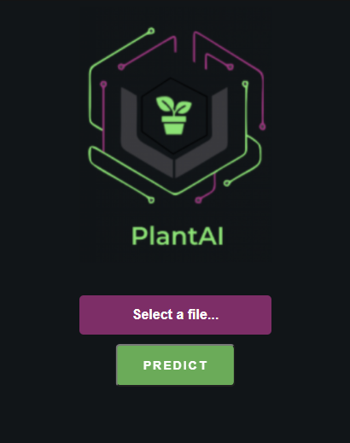
Demonstration

Slide 24
Thank you

